Slide 1


Nigel Ng
May 2025

Slide 2

Outline
Executive Summary
Introduction
Methodology
Results
Conclusion
Appendix

Slide 3
Executive Summary
Used GET request on SPACEX API and BeautifulSoup to webscrape the data used for the analysis.
Performed EDA using data visualization libraries such as Seaborn and Matplotlib to obtain a brief illustration of the given data. SQLite was also used to display results based on the given query.
Folium map was also created to exhibit the location of the individual launch sites, the success rate of each launch site as well as distance from a given launch site to proximities.
Dynamic dashboards were also created using Plotly Dash:
The most successful launch site is KSC LC-39A with a success rate of 41.7%.
CCAFS SLC-40 has the highest launch-success ratio with 42.9%.
Booster Version FT and payload range of between 2000 kg and 4000 kg demonstrates the highest success rate.
The data is normalized, split into training and testing data. GridSearchCV is then used to find the best parameters for each classification method:
Decision Tree classifier method returns the highest accuracy score on testing data with around ~0.875.
The recall and precision for Decision Tree classifier is found to be around ~92%.

Slide 4
Introduction
SpaceX is one the largest, and most successful space exploration companies:
Falcon 9 rocket launches are relatively inexpensive (62 million dollars).
The first stage of the launch is often reused.
Key problems to identify:
Determine the price of each launch.
Determine if first stage will be reused.
Predict the likeliness of SpaceX reusing the first stage in the future.

Slide 5

Section 1

Slide 6
Methodology
Executive Summary
Data collection methodology:
Describe how data was collected
Perform data wrangling
Describe how data was processed
Perform exploratory data analysis (EDA) using visualization and SQL
Perform interactive visual analytics using Folium and Plotly Dash
Perform predictive analysis using classification models
How to build, tune, evaluate classification models

Slide 7
Data Collection
SpaceX REST API
Web Scraping Wiki Pages
Create DataFrame using new list
Use Get Request on SpaceX API to obtain launch data
View response in DataFrame using .json_normalize()
Use Get Request on SpaceX API to append launch information to empty lists
Create BeautifulSoup object using WikiPage URL
Extract all column names from the targeted HTML table
Parsing the HTML table to append the data into dictionary
Create DataFrame using dictionary

Slide 8
Data Collection - API
SpaceX REST API (launches, information about the rocket used, payload delivered, launch specifications, landing specifications, and landing outcome)
GitHub URL of Data Colletion using API
Create DataFrame using new list
Use Get Request on SpaceX API to obtain launch data
View response in DataFrame using .json_normalize()
Use Get Request on SpaceX API to append launch information to empty lists

Slide 9
Data Collection - Scraping
Web Scraping Wiki Pages (BeautifulSoup)
GitHub URL of Data Scraping
Create BeautifulSoup object using Wiki Page URL
Extract all column names from the targeted HTML table
Parsing the HTML table to append the data into dictionary
Create DataFrame using dictionary

Slide 10
Data Wrangling
Data Wrangling Process:
Identiy and calculate percentage of missing values in data.
Identify categorical and numerical columns.
Create list of distinctive outcomes.
Create numeric class feature for outcomes for easier model filtering and visualisation.
GitHub URL of Data Wrangling
Handle missing values
Classify columns by data type
Extract distinct launch outcomes
Create numeric class feature for launch outcomes

Slide 11
EDA with Data Visualization
Charts generated:
Categorical plot of Flight Number vs Launch Site with Success indicated in colour
To explore how the success rate varies across the different flights and launch sites.
Scatterplot of Payload Mass and Launch Site with Success indicated in colour
Visualise how the success rate varies across the different launch sites and payload mass.
Bar Chart of Success Rate with varying Orbit Types
Check which orbit has the highest success rate.
Scatterplot of Flight Number and Orbit Type with Success indicated in colour
Visualise how the success rate varies across the different flights and orbit types.
Scatterplot of Payload Mass and Orbit Type with Success indicated in colour
Visualise how the success rate varies across the different payload mass and orbit types.
Line Chart of Average Success Rate across Time
Visualise the trend of success rate over the years.
GitHub URL of EDA with Data Visualisation

Slide 12
EDA with SQL
SQL queries performed:
Display the names of the unique launch sites in the space mission.
Display 5 records where launch sites begin with the string 'CCA'.
Display the total payload mass carried by boosters launched by NASA (CRS).
Display average payload mass carried by booster version F9 v1.1.
List the date when the first succesful landing outcome in ground pad was achieved.
List the names of the boosters which have success in drone ship and have payload mass greater than 4000 but less than 6000.
List the total number of successful and failure mission outcomes.
List all the booster_versions that have carried the maximum payload mass. Use a subquery.
List the records which will display the month names, failure landing_outcomes in drone ship ,booster versions, launch_site for the months in year 2015.
Rank the count of landing outcomes (such as Failure (drone ship) or Success (ground pad)) between the date 2010-06-04 and 2017-03-20, in descending order.
GitHub URL of EDA with SQL

Slide 13
Build an Interactive Map with Folium
Map Objects added to Folium Map:
Marker and circle indicating location and name of NASA Johnson Space Center.
Marker and circle indicating location and name for each launch site from the dataframe.
Mark success or failure for each launch site using red or green.
Mark line and distance between launch site to its proximities:
Nearest coastline
Nearest highway
Nearest city
Nearest railway
GitHub URL of Interactive Map with Folium

Slide 14
Build a Dashboard with Plotly Dash
Plots generated in the Dashboard:
Pie chart of total successful launch percentage from each launch site.
To visualize and compare the contribution of each launch site to the overall number of successful launches.
Pie chart of success to failure percentage of the selected launch site from a dropdown list.
Allows users to assess the performance of a specific launch site in terms of its success-to-failure ratio.
Scatter plot of number of successful launches across varying payload masses of a selected launch site.
Displays how launch success correlates with varying payload masses for the selected launch site, helping identify the payload ranges associated with higher success rates
GitHub URL of Plotly Dash

Slide 15
Predictive Analysis (Classification)
Model Development Process adopted:
Assign X as independent features and Y as the target variable.
Use StandardScaler to normalise feature values for consistent model performance.
Use train_test_split to split the variables into training and testing data.
Use GridSearchCV to find the best parameters to use for a given classification method.
Obtain the best parameters and accuracy for each model.
Generate confusion matrix for each method to visualise model precision.
GitHub URL for Predictive Analysis
Assign X and Y
StandardScaler() to normalise data
train_test_split on data
Find optimal parameters with GridSearchCV
Obtain best parameters and accuracy
Generate confusion matrix

Slide 16

Section 2

Slide 17
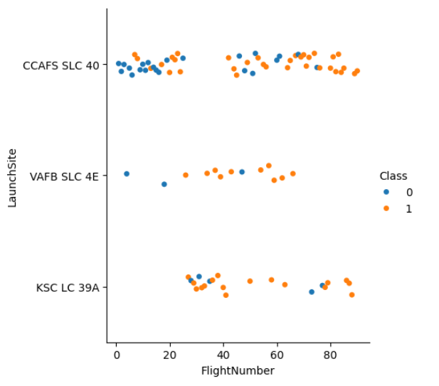
Flight Number vs. Launch Site
Most number of total launches are from Launch Site: CCAFS SLC-40
The number of successful launches for all sites increases with the number of flight
KSC LC 39A has the highest success rate among launches.

Slide 18
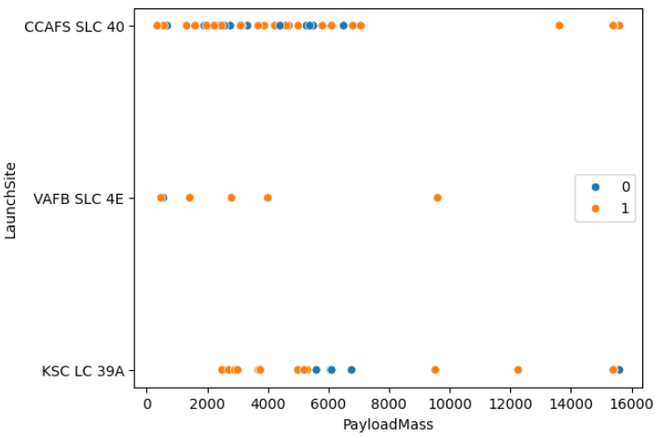
Payload vs. Launch Site
There are no launches with a payload mass greater than 10000 kg for launch site VAFB SLC 4E.
The number of attempted launches decrease significantly at a higher payload mass (above 80,000 kg).
Launch site CCAFS SLC 40 has the highest success rate of launches.

Slide 19
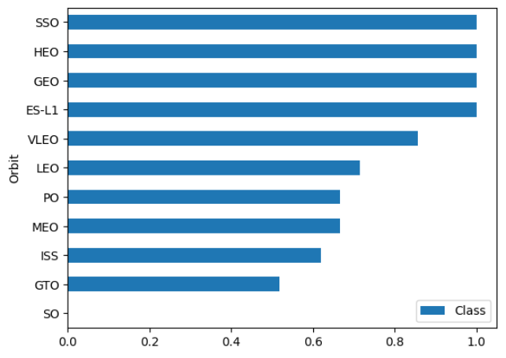
Success Rate vs. Orbit Type
Orbit SO has had zero successful launches.
Orbits ES-L1, GEO, HEO, and SSO have had 100 percent success rate in launches.

Slide 20
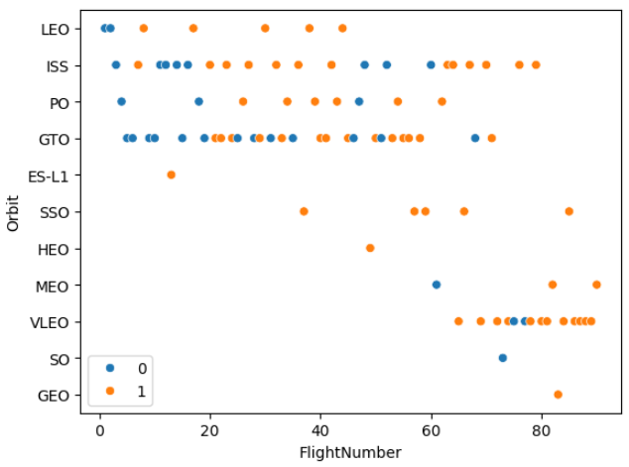
Flight Number vs. Orbit Type
Orbits ISS and GTO have the highest number of launches.
The success of launches from Orbit LEO increases with the number of flights.
The success of launches from Orbit GEO and SO has no correlation with the number of flights.

Slide 21
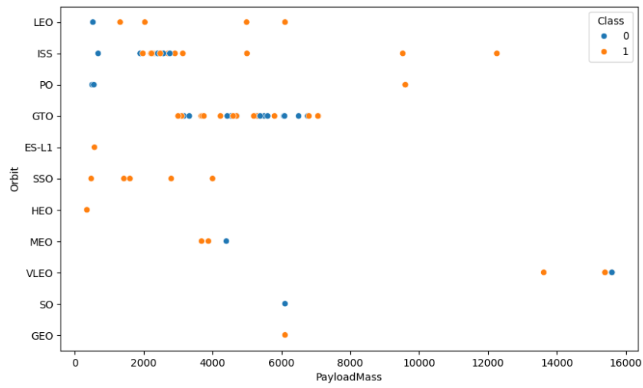
Payload vs. Orbit Type
The successful landing rate for orbits LEO, ISS and PO increase with heavier payload mass.
This trend does not present itself in orbits GTO, MEO and VLEO.

Slide 22
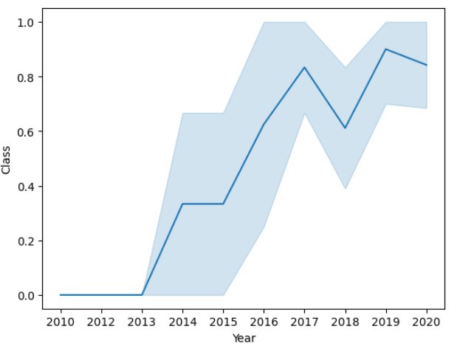
Launch Success Yearly Trend
The success rate displayed an increase from 2013 up to 2017, before decreasing in 2018, then increasing again in 2019.
Studies should be conducted to further analyse the reason for the decline in the year 2018.

Slide 23
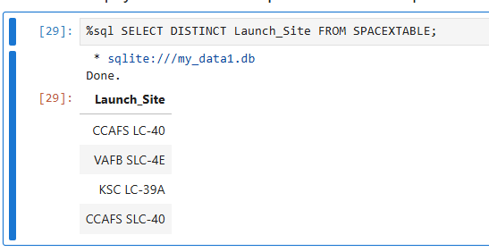
All Launch Site Names
The unique launch sites include:
CCAFS LC-40
VAFB SLC-4E
KSC LC-39A
CCAFS SLC-40
The DISTINCT keyword in SQL is used to retrieve unique values from a specified column.

Slide 24
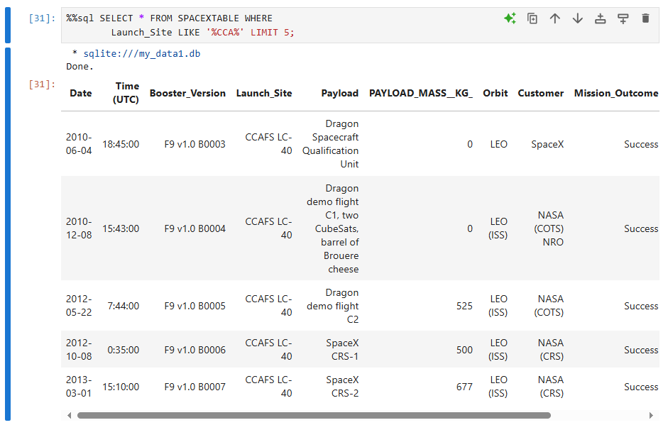
Launch Site Names Begin with 'CCA'
The keyword LIKE is used to filter rows based on a pattern match for a specified column.
The keyword LIMIT is used to restrict the number of rows returned by the query.

Slide 25
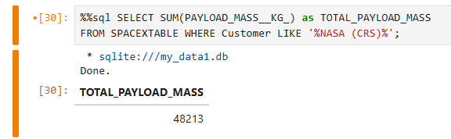
Total Payload Mass
Filter the query to only locate rows where the column ‘Customer’ includes the string NASA.
Obtain the total sum of payload mass by using the SUM() function on the ‘payload mass’ column.

Slide 26
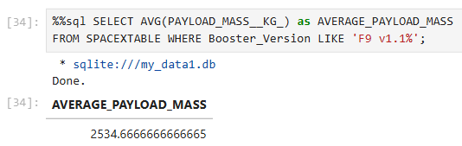
Average Payload Mass by F9 v1.1
Filter the query to only locate rows where Booster Version is F9 v1.1.
Obtain the average of payload mass by using the AVG() function on the ‘payload mass’ column.

Slide 27
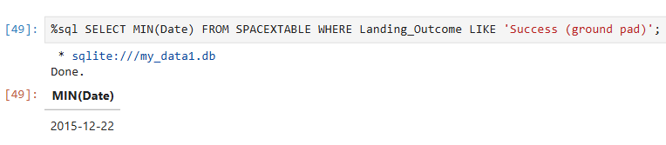
First Successful Ground Landing Date
The first successful ground landing data is 2015-12-22.
Filter the query by only limiting the landing outcome to Successful Ground Landings.
Using min() function on the Date column to obtain the lowest number (earliest date).

Slide 28
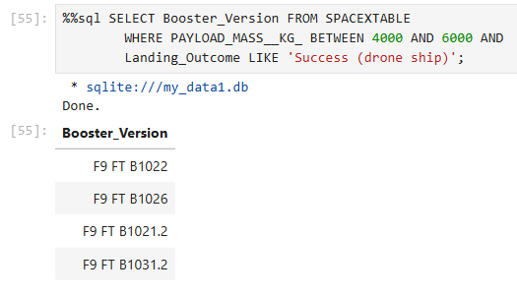
Successful Drone Ship Landing with Payload between 4000 and 6000
The names of boosters which have successfully landed on drone ship and had payload mass greater than 4000 but less than 6000:
F9 FT B1022
F9 FT B1026
F9 FT B1021.2
F9 FT B1031.2
Use BETWEEN … AND … function to filter data to the range of 4000 and 6000 kg.
Limit the data to only successful drone ship landings using LIKE

Slide 29
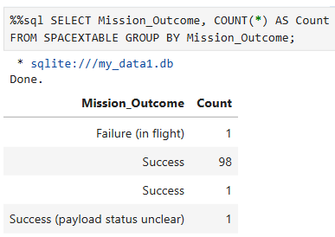
Total Number of Successful and Failure Mission Outcomes
The COUNT(*) function counts how many times each unique mission outcome occurs.
The GROUP BY function is used to group the data by each mission outcome type so the count is calculated per group.

Slide 30
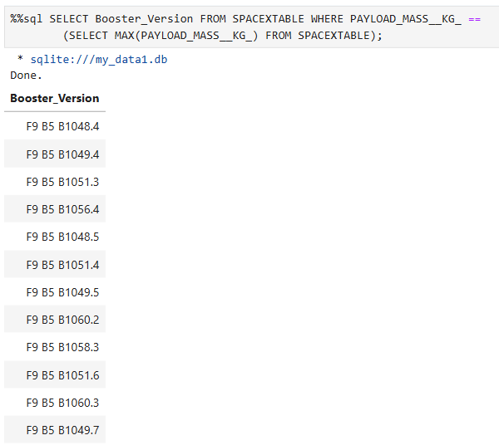
Boosters Carried Maximum Payload
A subquery was used to filter the rows where maximum payload mass was achieved.

Slide 31
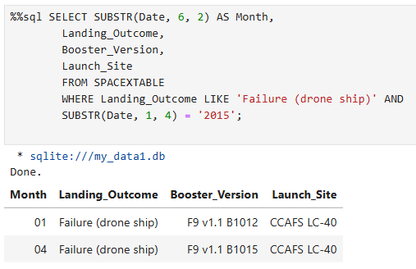
2015 Launch Records
Using LIKE to filter records where drone ship failure occurred.
As SQLite does not support month names, SUBSTR() function was used to limit the year to only 2015 data.
Returns the month, type of landing outcome, booster version and launch site.

Slide 32
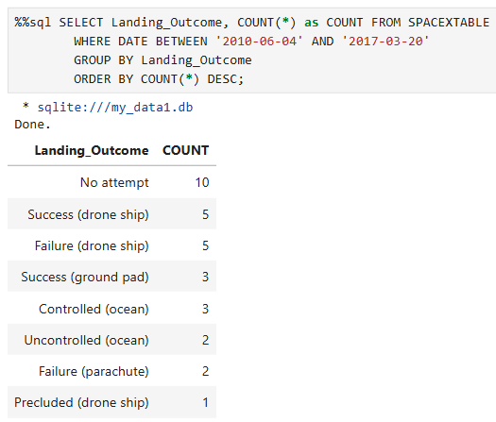
Rank Landing Outcomes Between 2010-06-04 and 2017-03-20
Query limits the result to launches conducted between 2010-06-04 and 2017-03-20.
Groups the data by each landing outcome type so the count is calculated per group.
Presents the data in order of descending occurrences.

Slide 33

Section 3

Slide 34
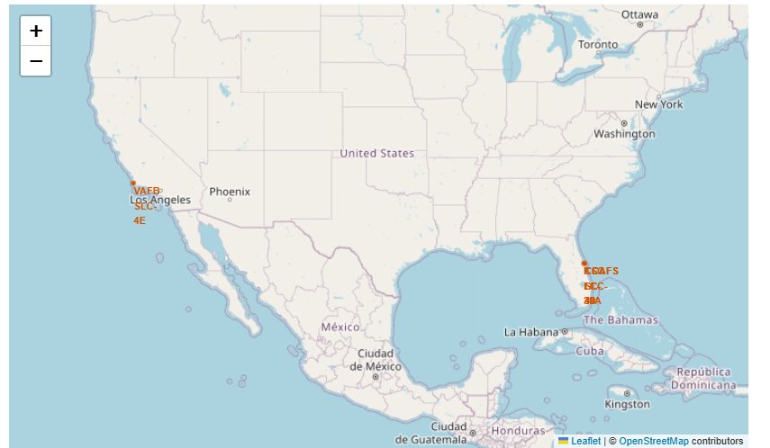
Folium Map of Launch Sites
The folium map indicated illustrates the location markers of all the launch sites on a global map.
From observation, all the launch sites are located in very close proximity to coastlines.

Slide 35
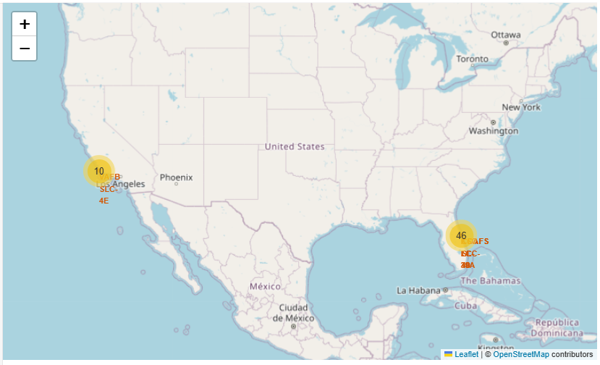
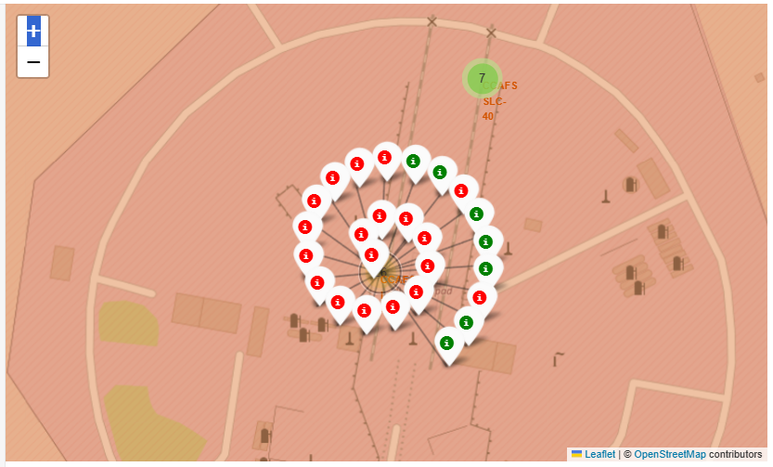
Folium Map of Color-Labeled Launch Outcomes
Creates markers for each launch record:
Green marker for successful launch.
Red for failed launch.
Easily view the success rate of launches at each launch site.

Slide 36
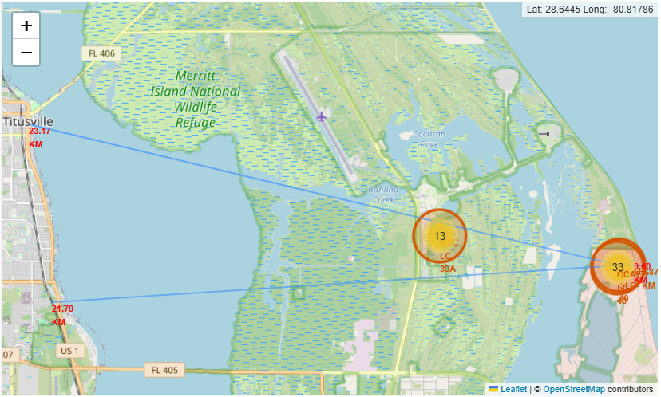
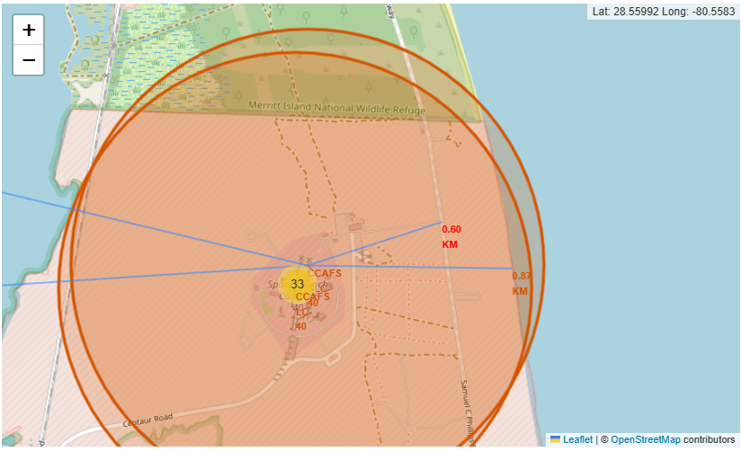
Folium Map of Launch Site to Proximities
Launch site CCAFS LC-40 is a given distance away from:
Nearest coastline: 0.87 km
Nearest railway: 0.60 km
Nearest city: 23.37 km
Nearest highway: 21.80 km
Most launch sites keep certain distance away from cities or where large amounts of people gather. Likely to prevent casualties in unforeseen circumstances.

Slide 37

Section 4

Slide 38
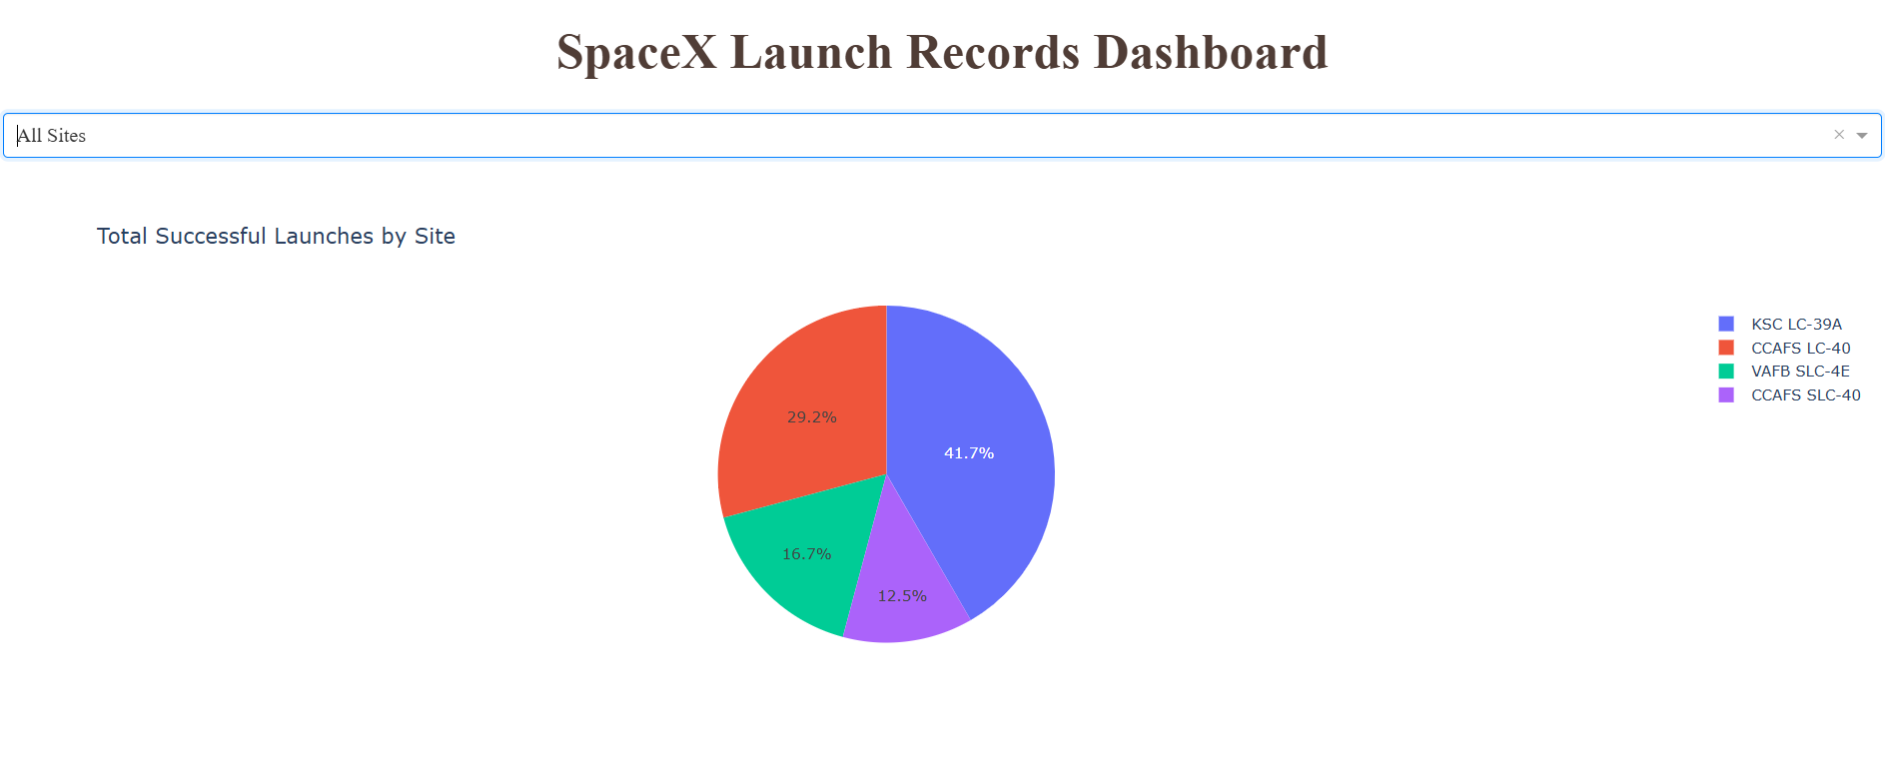
Launch Success Count for All Sites
The most successful launch site is KSC LC-39A with a success rate of 41.7%
The least successful launch site is CCAFS SLC-40 with a success rate of 12.5%

Slide 39
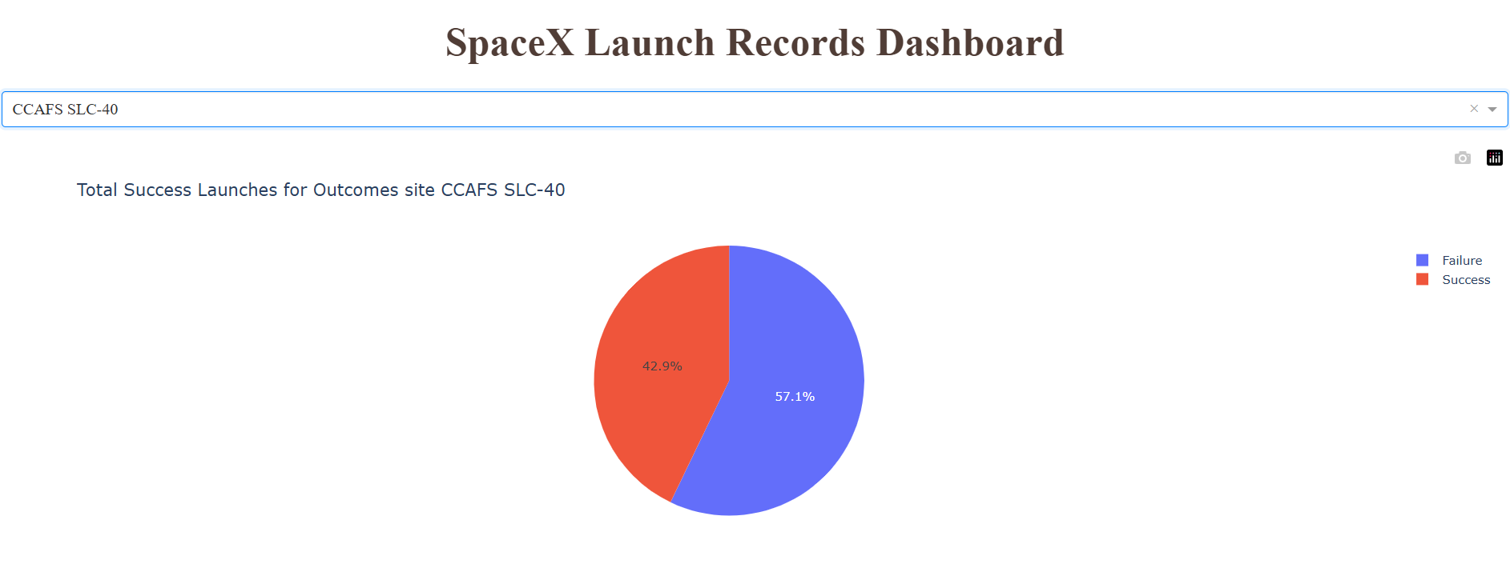
Launch Site with Highest Launch Success Ratio
Although having the lowest success rate, this launch site has the highest launch-success ratio with 42.9%
This could be explained due to:
CCAFS SLC-40 could have a low amount of launches overall
MOst of those launches were successful.

Slide 40
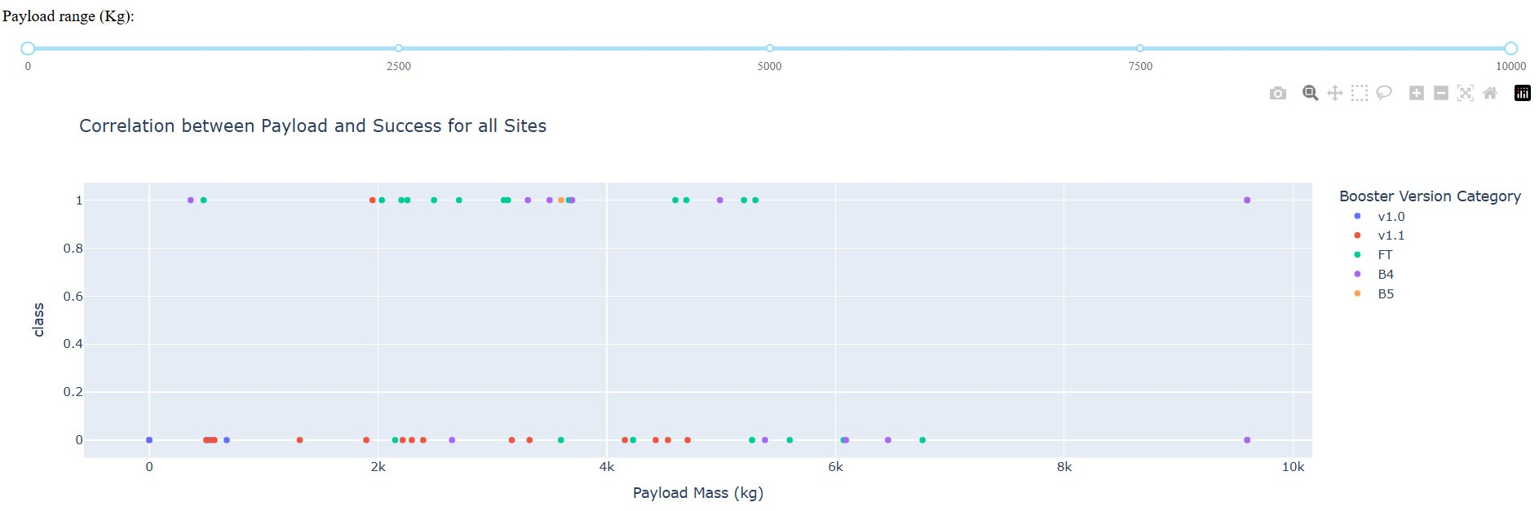
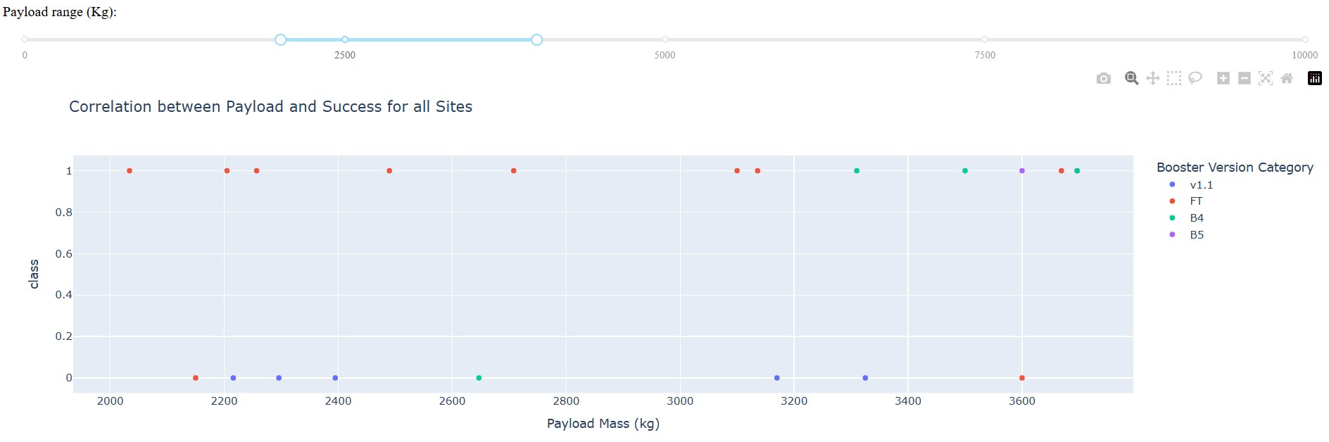
Most Successful Payload Range and Booster Version
Begin with broad view of the data.
Identify and remove the outliers.
Refine the view to focus on clusters of successful launches.
Identify patterns between features:
Booster Version Category – FT shows the highest success rate
The Payload Range of between 2000kg and 4000kg has the highest success rate.

Slide 41

Section 5

Slide 42
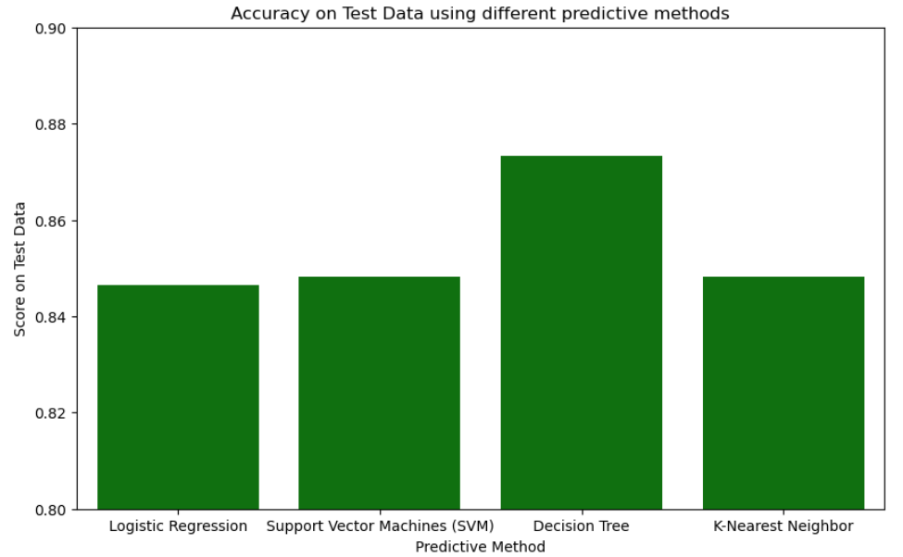
Classification Accuracy
Bar chart displays the score on test data for the different predictive methods used
Decision Tree has the highest test score with around 0.875.

Slide 43
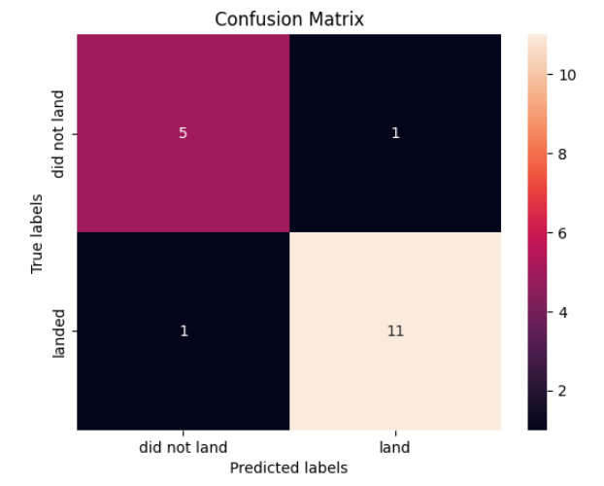
Confusion Matrix
Our Decision Tree model shows:
11 True Positives
5 True Negatives
1 False Positives
1 False Negatives
Overall not bad, incorrectly predicted 2 test results compared to other methods used which incorrectly predicted 3 results.
Precision and recall is 11/12 or around 92%.

Slide 44
Conclusions
The most successful launch site is KSC LC-39A with a success rate of 41.7%.
CCAFS SLC-40 has the highest launch-success ratio with 42.9%.
Booster Version FT and payload range of between 2000 kg and 4000 kg demonstrates the highest success rate.
Decision Tree classifier method returns the highest accuracy score on testing data with around ~0.875.
The recall and precision for Decision Tree classifier is found to be around ~92%.

Slide 45


